Slide 1



Adopt a Road Reporting
Keep Wakulla County Beautiful

Slide 2

Adopt a Road
Thank you to our volunteers for your efforts in assisting us with keeping our piece of paradise clean & litter free

Slide 3

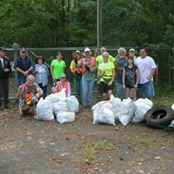
We love our volunteers!
Keep Wakulla County Beautiful is required to report our cleanup results. This is a condition of our grant that keeps us funded. As much as we appreciate what our volunteers do in picking up the litter, we do ask that these results be sent to us. This way we can provide the State of Florida and Wakulla County accurate information regarding our program. Some may choose to report once a month, some once a quarter, either is fine as long as we get the information.
Here is a very simple way to report your cleanup results.

Slide 4
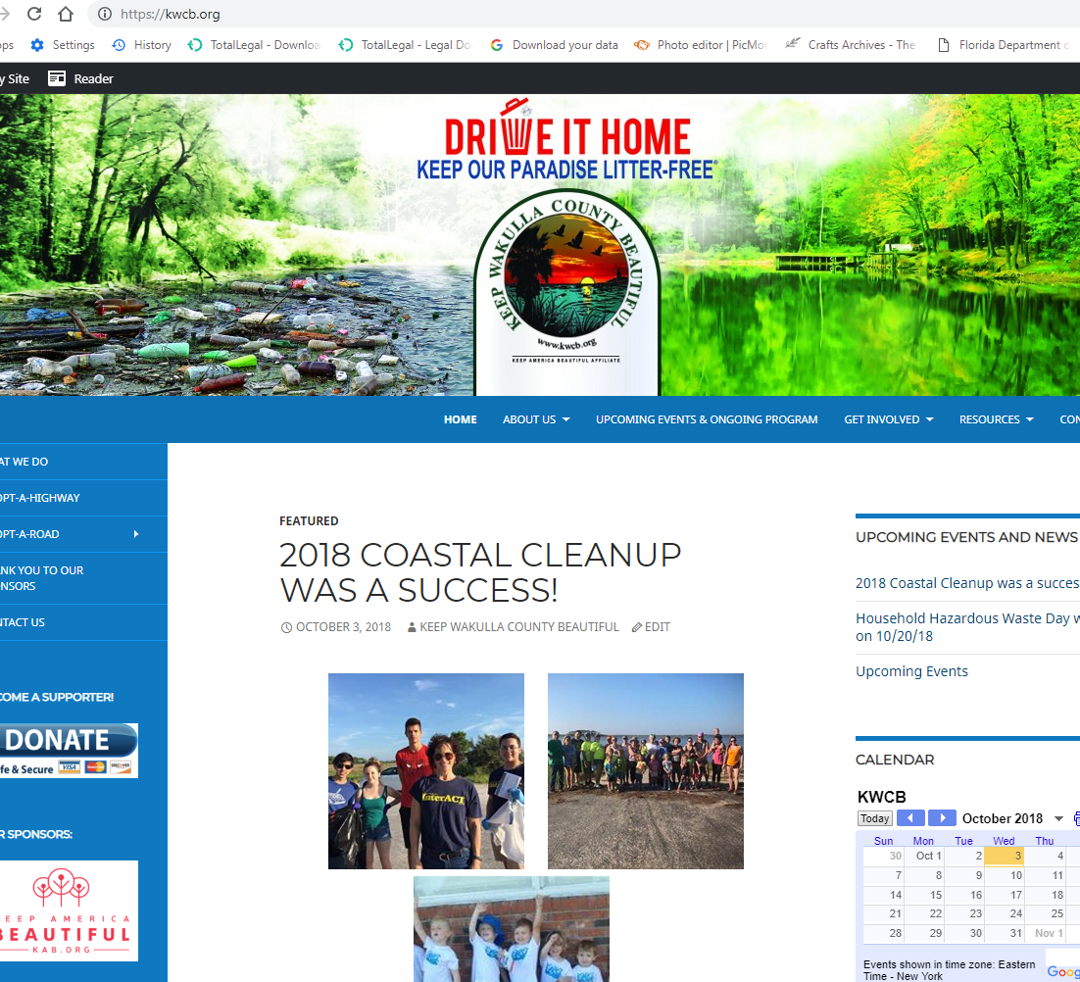
Visit our website!
First step in reporting is to go to kwcb.org and check out our website

Slide 5
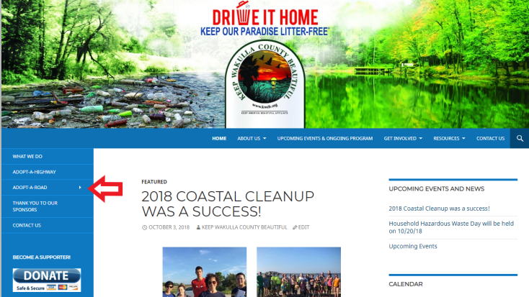
Find the Adopt a Road link on the sidebar

Slide 6
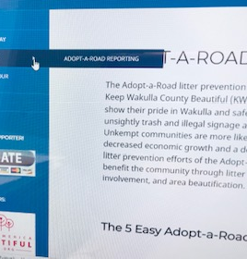
Don’t click yet!
Hover over the white arrow to bring up the Adopt a Road Reporting link. Click on this link to take you to the reporting page.

Slide 7
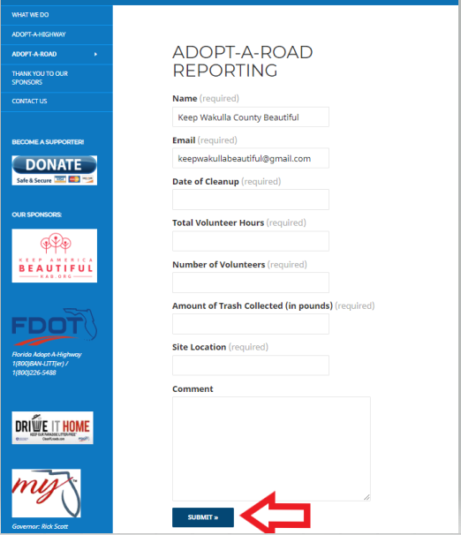
This is where we need your results!
Put in the name of your group/ family
Your contact email address
Date of the cleanup that you are reporting
Number of hours your cleanup lasted
Number of volunteers on your cleanup
How much was collected (see next slide for figuring approximate weights)
The location of your cleanup
Any additional comments. Do you need supplies? Is there something we need to have someone come remove? Want to say “hello”? Tell us in comments!

Slide 8
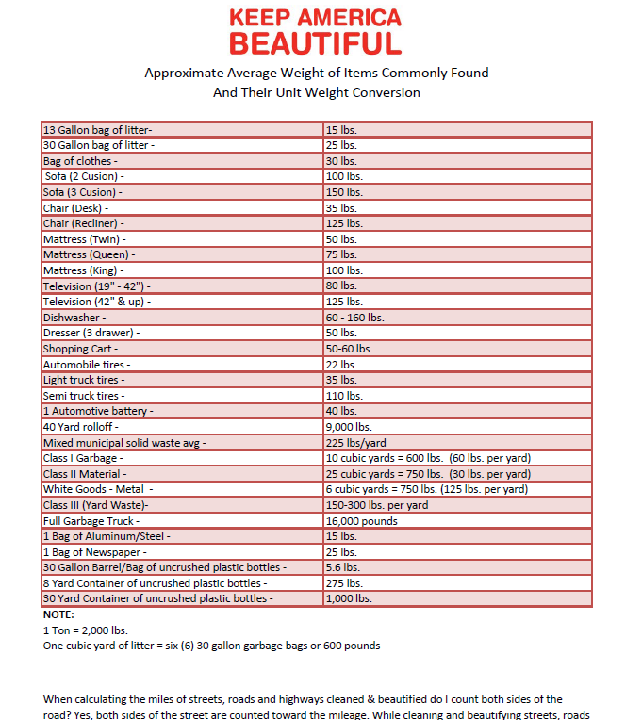
Use this chart to figure approximate weights for your cleanup

Slide 9


THANK YOU FOR YOUR PARTICIPATION
Keep Wakulla County Beautiful is so grateful for our volunteers. You make it happen!

